Slide 1

SHENGTONGYUAN
FRP PRODUCT CATALOG 2026
Fiberglass Reinforced Plastic Products
WhatsApp: +86 156 1080 1389 | Email: sales@frpfty.com | www.frpfty.com
Notes:
欢迎查阅晟通源2026年玻璃钢产品目录。我们是专业的玻璃钢（FRP）产品制造商，致力于为全球客户提供高品质、耐腐蚀、轻质高强的复合材料解决方案。本目录将详细介绍我们的主要产品系列和服务。

Slide 2
TABLE OF CONTENTS
01.Company Profile & Factory Strength
05.OEM Custom Service
02.Product Advantages
06.Trade Terms & After-sales
03.Full Product Range
07.Contact Us
04.Material & Application
FRP Product Catalog 2026 Edition
Notes:
这是我们产品目录的目录页。您可以看到，我们将从公司简介、产品优势、产品系列、材质应用、定制服务、贸易条款和联系方式等七个方面，全面介绍我们的产品和服务。

Slide 3
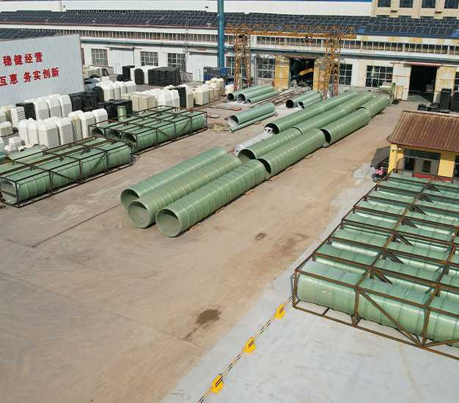


Company Profile & Factory Strength
SHENGTONGYUAN FRP
We are a leading manufacturer of high-quality Fiberglass Reinforced Plastic (FRP) products in China. With years of experience, we specialize in producing a wide range of FRP products including tanks, pipes, gratings, cooling towers, and custom profiles.
Our products are widely used in chemical, water treatment, power, construction, and other industries. We are committed to providing our customers with reliable, durable, and cost-effective solutions.
OUR CORE STRENGTHS
Advanced Production & QC
State-of-the-art lines & strict quality control standards.
R&D & Customization
Professional team to deliver tailored design solutions.
Notes:
我们是中国领先的玻璃钢产品制造商。凭借多年的经验，我们专业生产储罐、管道、格栅、冷却塔等各类玻璃钢产品。我们拥有先进的生产线、专业的研发团队和丰富的项目经验，致力于为客户提供可靠、耐用且高性价比的解决方案。

Slide 4




Why Choose SHENGTONGYUAN FRP?
Corrosion Resistance
Excellent resistance to a wide range of chemicals, acids, and alkalis. Long service life in harsh environments.
Lightweight & High Strength
High strength-to-weight ratio, easy to transport and install, reduces structural load.
Thermal & Electrical Insulation
Good thermal insulation and electrical insulation properties, suitable for special applications.
Design Flexibility
Can be molded into complex shapes and sizes to meet specific project requirements.
Notes:
选择我们的玻璃钢产品有四大核心优势：首先，它具有优异的耐腐蚀性，适用于各种恶劣的化学环境。其次，产品轻质高强，便于运输和安装。第三，它具有良好的隔热和电绝缘性能。最后，我们的产品设计灵活，可以根据客户的具体需求进行定制。

Slide 5
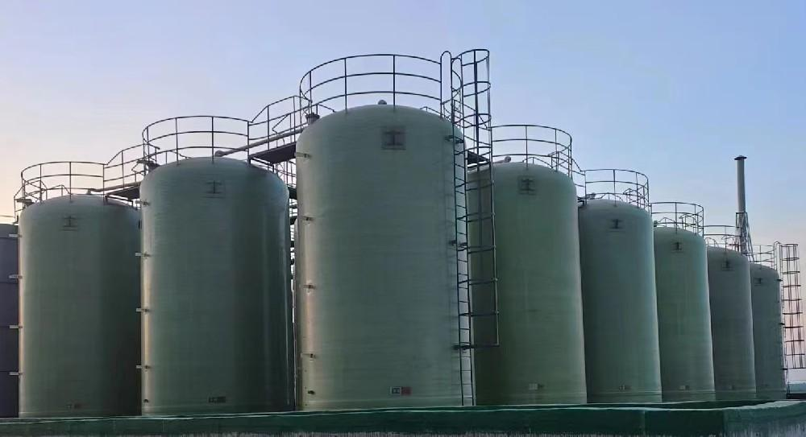
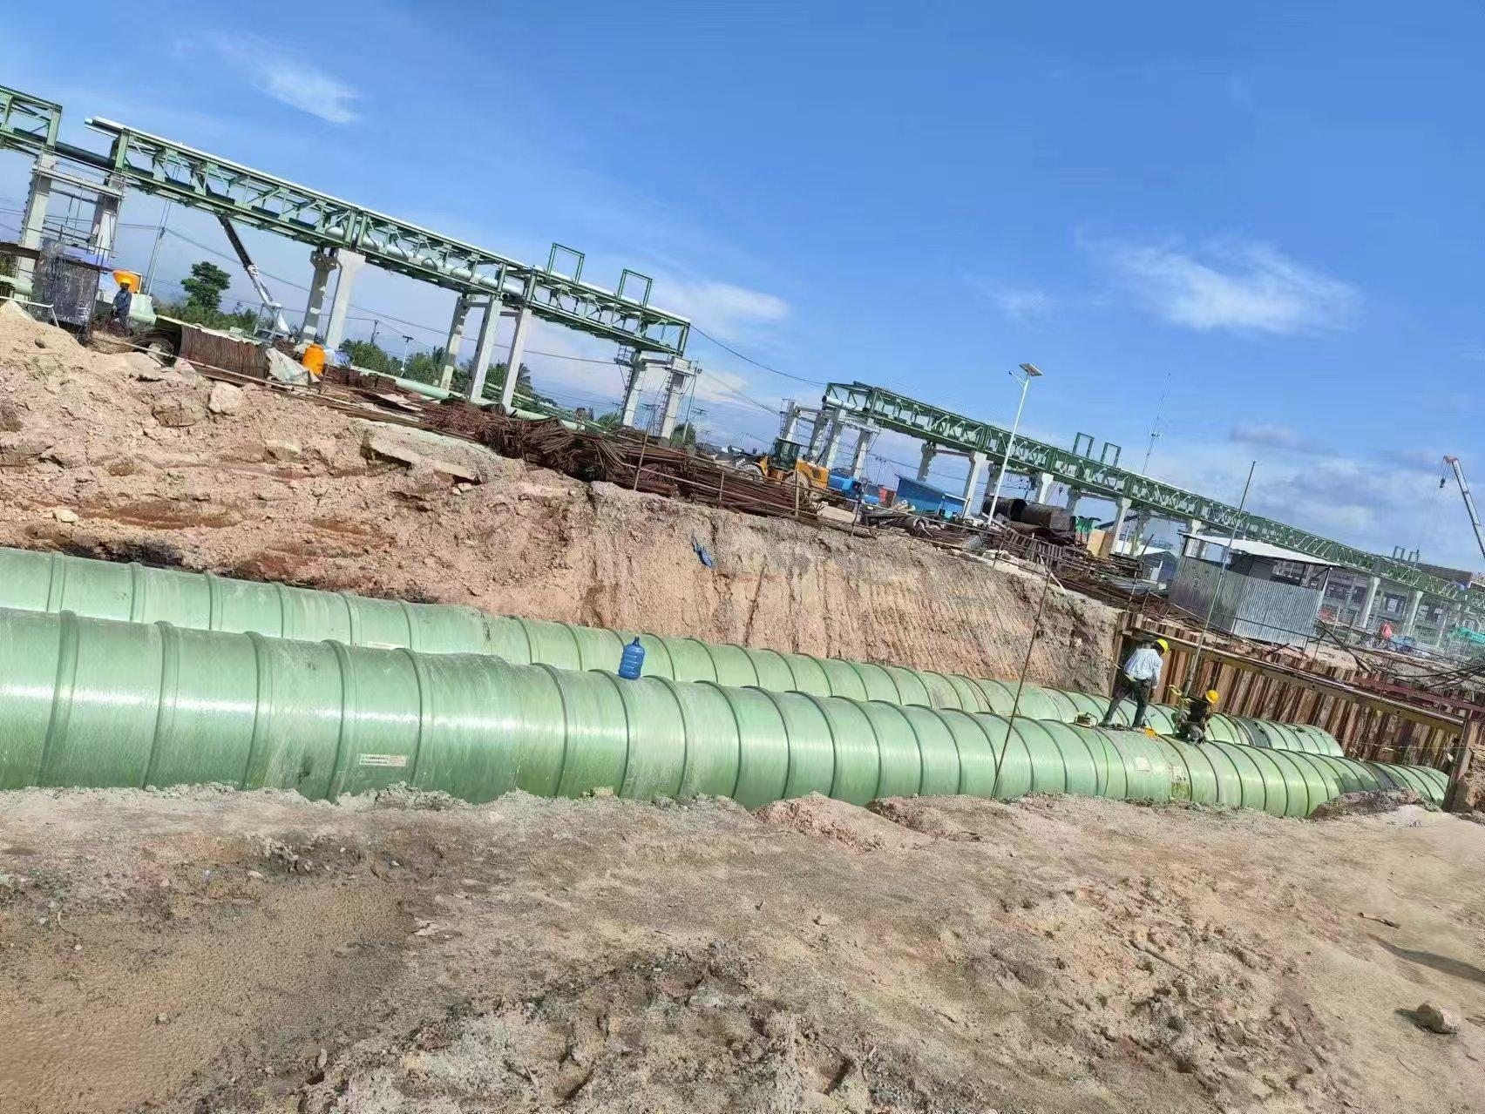
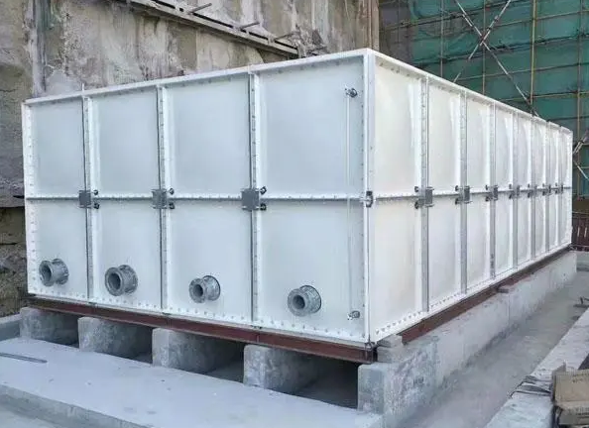
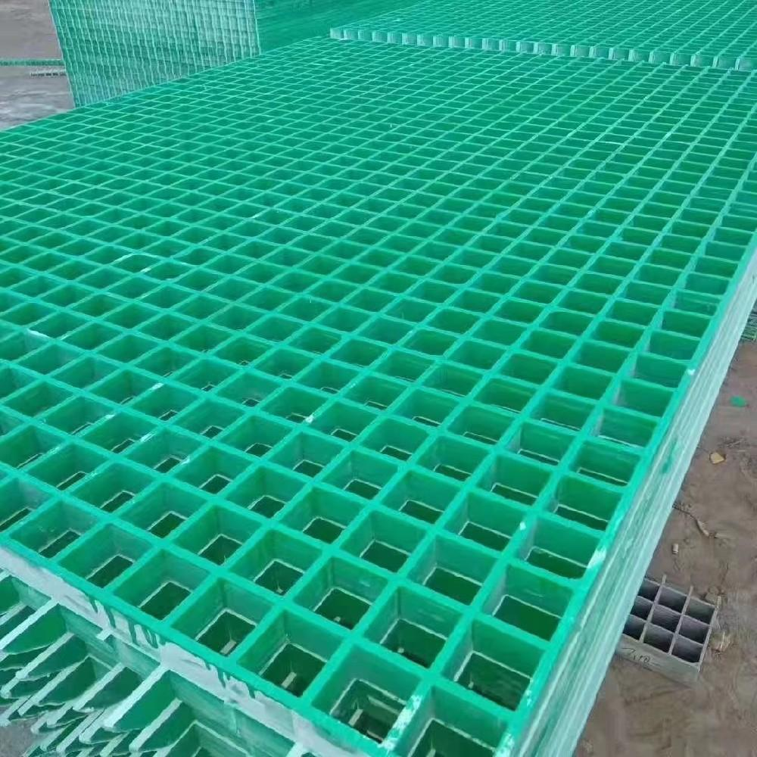
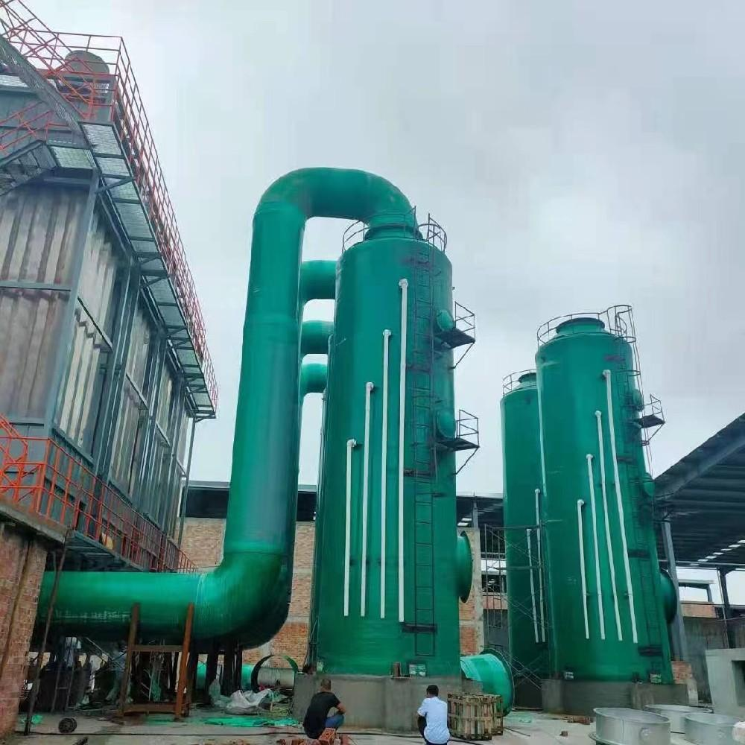
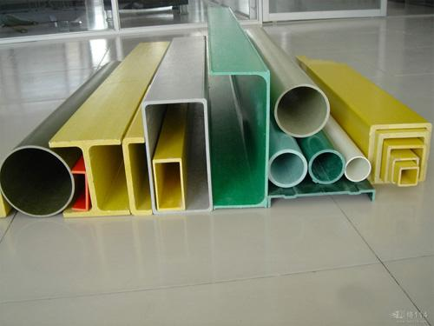
Our Product Range
FRP Tanks
FRP Pipes
FRP Water Tanks
FRP Gratings
FRP Towers
FRP Profiles
Notes:
我们的产品系列非常广泛，主要包括玻璃钢储罐、管道、水箱、格栅、塔器和型材等。这些产品广泛应用于各个工业领域，能够满足不同客户的多样化需求。

Slide 6

FRP Tanks
KEY FEATURES
• Available in vertical and horizontal configurations for flexible installation
• Fully customizable sizes and capacities to meet project-specific requirements
• Exceptional corrosion resistance, ideal for aggressive chemical storage
• Complete with standard accessories: manholes, nozzles, and safety ladders
INDUSTRIAL APPLICATIONS
•Chemical Processing:Storage of acids, alkalis, solvents, and other reactive liquids
•Water Treatment:Septic systems, pure water, wastewater, and desalination plants
•Food & Beverage:Storage of potable water, juices, and liquid ingredients
Notes:
这是我们的玻璃钢储罐系列。产品有立式和卧式两种类型，尺寸和容量均可定制。它们具有优异的耐腐蚀性，适用于化工、水处理、食品饮料等行业的各类介质储存。

Slide 7





FRP Pipes
KEY FEATURES
High Strength & Lightweight
Robust yet easy to transport & install
Low Flow Resistance
Ultra-smooth inner wall reduces energy loss
Superior Corrosion Resistance
Ideal for harsh chemical environments
Flexible Connections
Flange, adhesive, or bell & spigot options
PRIMARY APPLICATIONS
Chemical
Transport
Municipal
Water & Drainage
Power Plant
Desulfurization
Notes:
Our FRP pipes offer high strength, lightweight construction, ultra-smooth inner walls for low flow resistance, and superior corrosion resistance. With flexible connection options, they are widely used in chemical transport, municipal water & drainage, and power plant desulfurization systems.

Slide 8


FRP Water Tanks
KEY FEATURES
• Modular design, easy to assemble & expand
• Food-grade resin, safe for drinking water
• Lightweight, no rust, no leakage
• Excellent thermal insulation
COMMON APPLICATIONS
• Domestic / Municipal water supply
• Industrial process water storage
• Fire suppression & emergency water
• HVAC & chilled water buffer
Notes:
这是我们的玻璃钢水箱。它采用模块化设计，安装便捷，可灵活扩展。我们提供食品级树脂选项，确保饮用水安全。产品重量轻、不生锈、不漏水，是生活供水、消防储水和工业用水的理想选择。

Slide 9
FRP Gratings
FEATURES
• High strength, anti-slip surface
• Corrosion resistant, low maintenance
• Lightweight & easy to install
• Available in various sizes & colors
APPLICATIONS
• Platforms and walkways
• Trench covers
• Tree grates
• Stair treads
Notes:
我们的玻璃钢格栅具有高强度、防滑、耐腐蚀、免维护等优点。它重量轻，安装方便，有多种尺寸和颜色可供选择。广泛应用于操作平台、走道、沟盖板、树篦子和楼梯踏步等。

Slide 10

FRP Towers (Scrubbers)
KEY FEATURES
• High efficiency in gas absorption & purification
• Corrosion resistant to various flue gases
• Low pressure drop, energy saving
• Customizable design per process req.
INDUSTRIAL APPLICATIONS
• Flue gas desulfurization (FGD)
• Waste gas treatment
• Dust collection & chemical industry
Notes:
这是我们的玻璃钢塔器系列，主要用于气体吸收和净化。它具有高效、耐腐蚀、压降低、节能等优点。我们可以根据客户的工艺要求进行定制设计，广泛应用于烟气脱硫、废气处理和化工等领域。

Slide 11
FRP Profiles
KEY FEATURES
• High strength-to-weight ratio, making them durable yet easy to handle
• Excellent resistance to corrosion and harsh weather conditions
• Flexible and easy to cut, drill, and install on-site
• Available in diverse structural shapes (Angle, Channel, Tube, I-beam)
COMMON APPLICATIONS
• Construction of durable FRP structures, platforms, and support systems
• Safety handrails, walkway barriers, and fencing for industrial sites
• Electrical and thermal insulation components for power and telecom sectors
• Bespoke FRP products for specialized engineering needs
Notes:
我们的玻璃钢型材包括角钢、槽钢、圆管等多种形状。它们具有高强度、轻质、耐腐蚀、耐候性好等特点，易于切割和安装。广泛用于制作玻璃钢结构件、护栏、绝缘部件等。

Slide 12







Material & Application
Material Introduction
Application Industries
Resins- Orthophthalic, Isophthalic, Vinyl Ester resins for different corrosion resistance.
Chemical
Industry
Water
Treatment
Power
Generation
Fibers- E-glass, C-glass, S-glass fibers for different strength & performance.
Const.
& Arch.
Municipal
Eng.
Trans-
port
Additives- UV inhibitors, fire retardants, etc.
Notes:
We select high-quality resins (e.g., Orthophthalic, Isophthalic, Vinyl Ester) and fibers (e.g., E-glass, C-glass) as raw materials, with additives like UV inhibitors and flame retardants. Our products are widely used in Chemical, Water Treatment, Power, Construction, Municipal, and Transportation industries.

Slide 13




OEM & Custom Service
Custom Design
Color Custom
Logo Printing
Accessories Custom
Size Custom
According to your drawings and technical requirements.
Custom RAL colors available to match your brand.
Print your company logo on the products.
Customize nozzles, flanges, ladders, and other parts.
Any size and thickness can be manufactured.
Notes:
我们提供全面的OEM和定制服务。无论是根据您的图纸进行定制设计，还是定制颜色、印刷LOGO、配置附件，我们都能满足您的个性化需求。任何尺寸和厚度的产品我们都可以生产。

Slide 14







Trade Terms & After-sales
TRADE TERMS
AFTER-SALES GUARANTEE
Port:Qingdao / Shanghai / Tianjin
Warranty:1-5 years warranty for different products
Trade Term:EXW / FOB / CIF / CFR
Tech Support:Comprehensive support & guidance
Payment:T/T, L/C
Quality:Free replacement/repair for quality issues
Lead time:According to order quantity and complexity
Follow-up:Regular follow-up to ensure satisfaction
Notes:
We offer flexible trade terms (EXW, FOB, CIF, CFR) and payment methods (T/T, L/C). We provide 1-5 years warranty, comprehensive technical support, and installation guidance. For confirmed quality issues, we commit to free replacement or repair. We also offer regular follow-up services to ensure your satisfaction.

Slide 15





SHENGTONGYUAN FRP
Professional FRP Products Manufacturer
WhatsApp
+8615610801389
Email
sales@frpfty.com
Website
https://www.frpfty.com
Address
No. 356, Yuhua East Street, Zaoqiang County, Hengshui City, Hebei Province, China
Notes:
感谢您的关注！如果您对我们的产品感兴趣或有任何疑问，请随时通过以上方式联系我们。我们期待与您建立长期的合作关系。

